Slide 1
What is the best method of capacity planning for my facility?
Bob Kotcher, President
Simitar Consulting

Slide 2
Agenda
Cost of capacity-planning errors
Two basic types of capacity planning
How your facility’s characteristics point you toward the appropriate method

Slide 3
Cost of capacity-planning errors
Overcapacity
Equipment , facility, and labor costs
Layoffs
Undercapacity
Lost sales
High cycle times
High WIP
Reduced service levels

Slide 4
Two types of capacity planning
Static
Dynamic

Slide 5
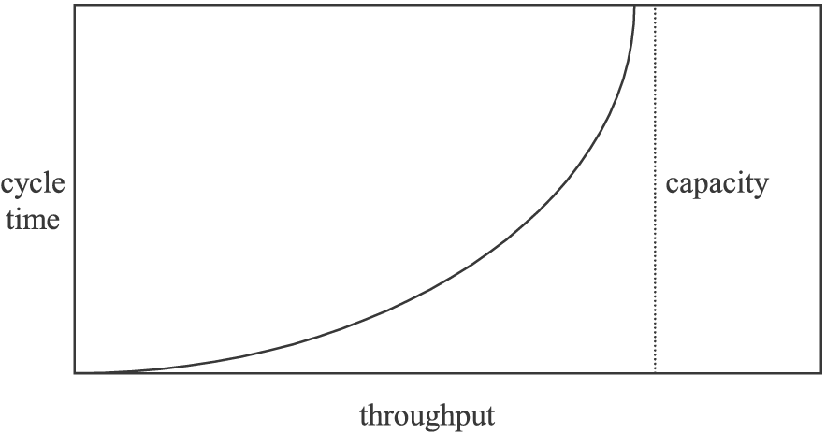
Dynamic modeling
Also known as stochastic, Monte Carlo, or discrete-event simulation (DES)
Variability causes cycle time to approach infinity as loading approaches 100%

Slide 6
Dynamic modeling
Demo of models:
Factory Explorer
Simio

Slide 7
Pros/cons of static vs. dynamic
PARAMETER | STATIC MODEL | DYNAMIC MODEL
The Build
Cost
Time
Expertise req’d
The Analyses
Setup time
Run time
Interpretation time
Expertise req’d
Ease of understanding by others
Model Maintenance
Labor
Expertise req’d
Output of the Model
Throughput and % loading
Predicts cycle times, WIP levels, and service levels
Can be used to optimize processes

Slide 8
Optimizing processes--things with which you can experiment in a dynamic model
Dispatching (prioritization) rules at each operation
Batching rules
Setup rules
Resource allocation
Resource cross-qualification
Lot sizes
Kanban quantities

Slide 9
Conclusion
Your facility’s characteristics point you toward a method, per this matrix:
PARAMETER | LOW | HIGH
Your facility’s complexity | Static | Dynamic
Your facility’s variability | Static | Dynamic
Your facility’s budget | Static | Dynamic
The importance of accuracy | Static | Dynamic

Slide 10
Summary
Cost of capacity-planning errors
Two basic types of capacity planning
How your facility’s characteristics point you toward the appropriate method

Slide 11
Discussion/Questions
Further reading: http://www.simitarconsulting.com/uploads/FabTimeNewsletter--my_article.pdf
Anyone want to describe his/her facility so that the group can assess it toward the best method?
Contact info:
BobKotcher@SimitarConsulting.com
www.SimitarConsulting.com
http://www.linkedin.com/in/robertkotcher
(877) 365-9997

